Slide 1

Strategic, Scalable
IT Solutions for Business
Bespoke. Solutions. Delivered.

Slide 2




Our Leadership Team
Our leadership team drive our business forward with our shared vision in mind. They are agile, responsive and committed to our clients’ needs.
Lewis Pennell Technical Director
Craig Summers
Project Director
Elaine Ladyman
Operations Director
Penntech was born out of my passion for delivering professional IT services from a personal stance.
I don’t believe that we need to wear suits or follow the norm to be able to offer a first-class service.
Prior to joining Penntech I worked for various MSPs cross sector.
I now manage the Project team to ensure that Penntech deliver the highest standard of services to our clients.
I joined Penntech post-sale of my business in the role of Business & People Manager.
I now work with the team developing and supporting the business and its valued Clients.
D: 02033 711 810
M: 07834 774474
lewis.pennell@penntech-it.com
D: 02033 711 810
M: 07538 569835
craig.summers@penntech-it.com
D: 02033 711 810
M: 07511 695183
elaine.ladyman@penntech-it.com

Slide 3

Penntech IT Solutions are a managed service provider specialising in the delivery of strategic, scalable IT solutions to a range of small and medium enterprises.
We work across a wide range of industries, including, but not limited to, Education, Private Equity, and Insurance. Our clients come first in everything we do. We care about their business and what they think of our service.
This deck is an overview of the services we provide. Not one size fits all. If you would like specific pricing, with absolutely no obligation, one of our Engineers will carry out a free audit and provide the best fit aligned to your business objectives, including budgetary constraints.
We are confident that our solutions are the most competitive in terms of costs and service excellence, but we provide like for like quotes if we’re put to the challenge.

Slide 4








Why Penntech?
Eight reasons why we’d be great together
Do we provide great IT Support to SMEs?
Absolutely that’s what our Clients tell us. But why would you want to partner with us?
1
2
3
4
5
6
7
8
Contract duration
We don’t tie our
clients into long
contracts as we
don’t believe we
need to
Customer centric
Our customers are our reason for being
Straight talking
Who needs jargon?
Fast response
Knowing your request
has been received
brings peace of mind
Knowledgeable
We believe in continuous development
for all our engineers
Vendor agnostic
Not one size fits all
One-stop
We manage external partnerships and relationships, so our clients don’t have to
Secure
Protecting your business data

Slide 5
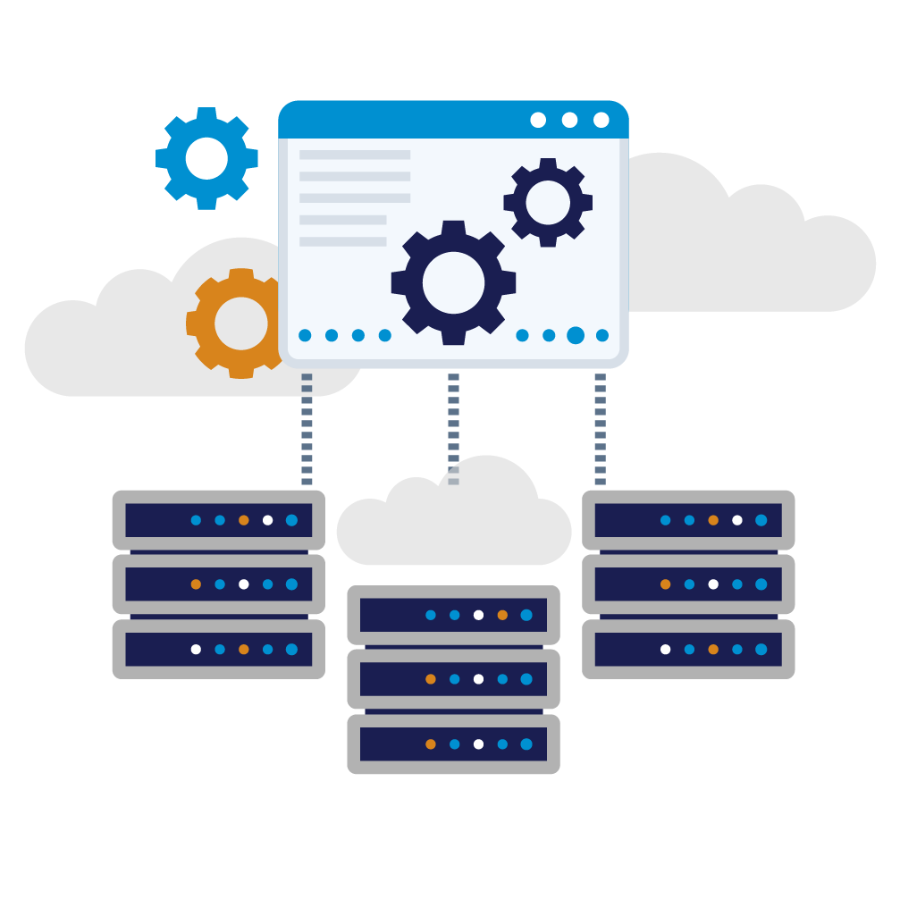
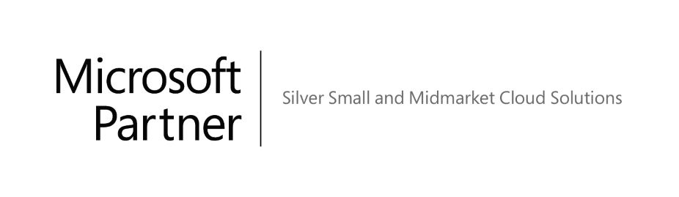
Procurement & Partners
Technology isn’t one size fits all
We choose vendors and solutions based on your needs and best fit, not ours.
We are recognised by industry leaders as IT Technology Partners due to our expertise in our field (which we have to demonstrate, not simply claim). Through technology partnerships, we are able to share economies of scale with our clients, which enables a cost differentiation against other IT service providers.
Our vendor-agnostic approach enables our clients to be reassured that we’re finding the right solutions for their business requirements and not piecing together products from a preferred supplier list.

Slide 6
Managed Support Services
IT Support & Consultancy
Outsourced Service Desk
Technology isn’t one size fits all and neither should your Managed IT Services.
Our outsourced support service enables you to efficiently manage your corporate IT budget. To further consolidate IT outgoings, we can manage anything from domain and web hosting to online backups and antivirus.
Onsite Support or Overflow
We’re here to support your business in any way that we can.
This includes offering overflow resource for your internal helpdesk on daily tasks, filling knowledge gaps during project delivery or holiday cover for your current IT Manager.
Disaster Recovery
With the introduction of disaster recovery as a service, we can minimise downtime with regular daytime backups and off-site replication to the cloud.
Finding an IT partner that seamlessly integrates into your business is a fundamental element in promoting continued business growth.
Monitoring & Maintenance
Ideal for businesses that aren’t at the stage where they require a fully managed IT Support package, but would benefit from alerting and automated maintenance.
Infrastructure Audit
Are you concerned about the setup of your current IT systems?
Our infrastructure audits review your current setup, both on-premises and in the cloud to ensure that you’re following industry recommended best practices.

Slide 7

Communication & Collaboration
Connectivity & Communication
Cloud Telephone Systems
Telephony services have changed in recent years as internet connectivity has become more stable on a global level.
The introduction of cloud-based telephony allows you to save costs of your calls while providing higher availability, security and the ability to quickly and easily scale these services up or down.
Internet Connection
In recent years, the cost of internet connectivity has decreased dramatically while the reliability and availability has increased. We partner with selected internet service providers to offer you the most competitive rates available with the most reliable service.
Whether you’re looking for a fibre, leased line, MPLS or radio wireless networks we can provide you connectivity with speeds of up to 10Gbps.
Unified Communications provide the ability to bring dispersed workforces together to communicate and collaborate more effectively than
ever before.
Video Conferencing
We work with a variety of leading video conference vendors to provide a service that is suitable for your business both now and in the future.
Whether you’re looking for a system to integrate a boardroom or remote workers, we can implement the perfect system which works for everyone.

Slide 8
Cybersecurity
Security
Cyber Essentials
Cyber Essentials is a scheme back by the British Government which helps you to guard against the most common cyber threats and demonstrate your commitment to cybersecurity.
Our role at Penntech is to implement Cyber Essentials compliant security on your infrastructure.
Multi-Factor Authentication
Weak or stolen user credentials are used in 95% of all web application attacks.
MFA services offer a second level of authentication for your web apps. After a simple username and password input, you must then either respond to a call, text or application notification to gain full access to your device.
Mobile Device Management
The introduction of bringing your own device (BYOD) poses a new threat to security.
How do we secure the business aspect of the device without hindering the user’s personal access?
Mobile device management (MDM) solutions provide organisations with the ability to contain information and maintain control over their data.
IT security is a topic that all companies, large or small, should be considering.
Other services
There are many Cybersecurity aspects to consider such as Vulnerability Scanning or Managed SOC for example. The list is not intended to be exhaustive.
Email protection
Did you know that over 91% of targeted Cyber-Attacks start with email?
Our email security solutions offer advanced protection against a multitude of email bounce attacks, including malware, phishing, malicious links and impersonation.
Device encryption
Our suite of encryption tools can be centrally managed and applied to laptops, desktops, mobile devices and USB sticks.
Once encrypted using AES 256-bit encryption the data on these devices is not accessible unless you have the keys to unlock it.
Penetration Testing
Protecting your valuable assets and customer data is paramount in today's digital landscape. Alongside robust security software, regular network penetration tests play a critical role in protecting your business.

Slide 9

Consultancy
Consultancy
Strategy
Our approach involves taking a detailed look at where you’ve been, where you plan to be and your current IT Infrastructure. Armed with this information we’re able to build a technical strategy to ensure that your systems are scalable, reliable and secure.
Technical Audits
Are you concerned about the setup of your current IT systems? Our infrastructure audits review your current setup, both on-premises and in the cloud to ensure that you’re following industry recommended best practices.
Procurement
By partnering with industry-leading wholesalers, we can offer our clients competitively priced hardware from almost every vendor available.
Our vendor-agnostic approach enables our clients to be reassured that we’re finding the right solutions for their business requirements and not piecing together products from a preferred supplier list.
Whether you’re a start-up looking for a simple setup, an established business looking to migrate your IT systems from physical to virtual
infrastructure, or an IT department that needs some assistance.
We offer consultancy and project management solutions to suit your requirements.
Projects
Using multiple tools at our disposal we’re able to cost-effectively deliver projects on time and in budget.
Our team of engineers can deliver a range of projects including infrastructure design, deployments and upgrades, email security, unified communication deployments and email migrations.
Infrastructure
Guaranteeing that your infrastructure is configured to be optimised, reliable and secure we look at everything from staff hardware to servers, wireless, telephony and disaster recovery to the physical security of these devices.

Slide 10

Cloud Solutions
Cloud Solutions
Cloud Infrastructure
Your company’s IT infrastructure is the backbone of your service delivery. We look at the whole lifecycle, from design and implementation to maintenance, upgrade and decommissioning.
Cloud Telephony Services
The introduction of cloud-based telephony allows you to save costs of your calls while providing higher availability, security and the ability to quickly and easily scale these services up or down.
How do you know whether the cloud is the right solution for your business?
Penntech Solutions is here to take the confusion out of the cloud and put your business on the right path.
Cloud Signature Management
We’re selected to partner with Exclaimer to enable our clients to implement consistent email signatures.
Exclaimer can be used to increase brand awareness and portray a professional image to recipients wherever you’re sending the email from.
Cloud Email
In recent years, companies large and small have made the move to cloud-based emails solutions such as Office 365 and G Suite.
Such providers offer businesses a highly available, enterprise-grade email solution at a fraction of the cost.
Collaboration no longer requires everyone to be sitting in the same office discussing a document or project.

Slide 11

Let’s do something good together
Tel: 02033 711 810
hello@penntech-it.com
www.penntech-it.com

