Slide 1

Assess Your Overall Security Before Attackers Do
Penetration Testing Services
CREST Certified
Strategic, Scalable
IT Solutions for Business
Bespoke. Solutions. Delivered.

Slide 2



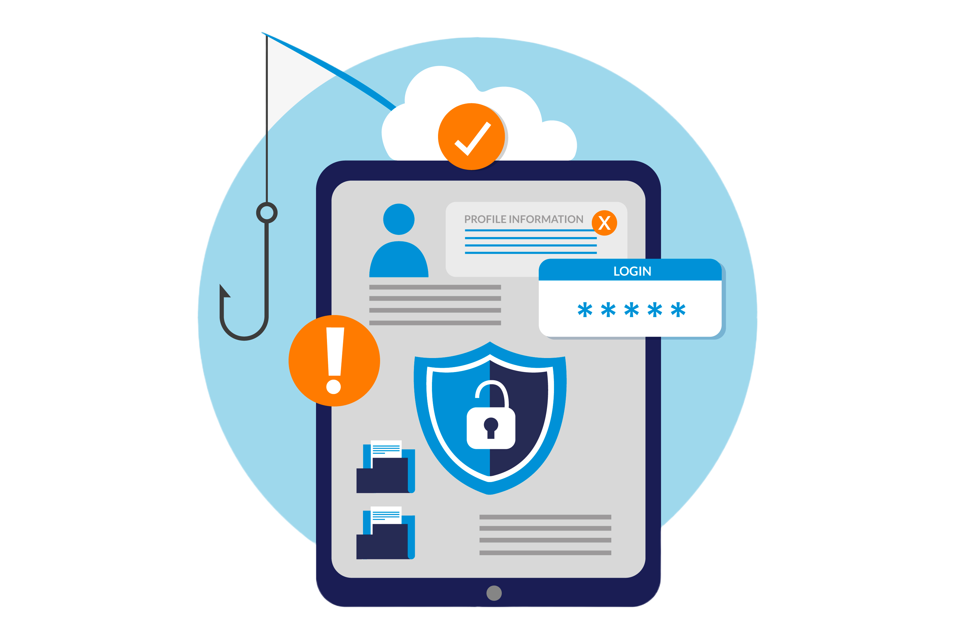

How do Data Breaches Occur?
A data breach occurs when a stealthy cybercriminal infiltrates a data source and extracts confidential information, often without the victim's knowledge.
This can be done by accessing a computer or network to steal local files or bypass network security remotely.
Penetration testing is effective in exposing how threat actors could break into and move across your network to Access, Manipulate, Damage, or Sell valuable data and systems within your business.
The most common cyber attacks used in breaches are outlined below.
Ransomware
Malware
Phishing
Denial of Services (DOS)

Slide 3


An Era with Data Breaches on the Rise
2005
2022
157
data breaches
66.9 million
records exposed
11,476
data breaches
1.66 billion
records exposed
61% of small to medium businesses are now being hit by cyber-attacks every year, and the average cost of a cyber attack has increased to £4 million.
This makes it extremely difficult for businesses to recover.

Slide 4


The best defence is a good offence
Offensive Security
Defensive Security
Offensive Security includes:
Defensive Security includes:
Vulnerability Assessments
Penetration Testing
Social Engineering
Implementing Controls
Security Monitoring
Incident Response
Penetration testing effectively exposes ways in which threat actors could break into and move across your network to Access, Manipulate, Damage, or Sell valuable data and systems within your business.
Focusing on defensive security alone, as many companies do, is a fundamentally flawed security strategy.

Slide 5
Does your Business Need a Penetration Test?
Penetration tests allow organisations to assess their cyber security posture based on realistic attack scenarios, which enables them to address issues that would be overlooked if they followed a solely defensive approach.
Penetration tests reveal crucial security flaws.
They expose issues beyond the scope of vulnerability assessments.

Slide 6
Penetration Testing and it’s Purpose
01
Demonstrate real-world risk
by simulating a malicious threat actor
Evaluate current security detection and monitoring controls.
Provide businesses with remediation strategies to mitigate risk.
Understand how attackers target their most confidential/sensitive data
02
03
04

Slide 7

We make Penetration Testing Affordable
According to the U.S. Small Business Association, SMBs with fewer than 100 staff members account for 98% of all US companies—that’s 5.7 million businesses.
90% of these businesses, often with fewer than 20 employees, are burdened by the high cost of traditional annual penetration tests, ranging from $3-5k for a business of that size.
The figures are the same in the UK.
Penntech deploys the latest technology, which helps our team perform penetration testing more efficiently. We pass those savings on to you to bring you Penetration Testing at an affordable cost with:
Real-time tracking of attacks and findings
Reports available within 24 hours of the penetration test completion
Remediation support

Slide 8



Our Leadership Team
Our leadership team drive our business forward with our shared vision in mind. They are agile, responsive and committed to our clients’ needs.
Lewis Pennell Technical Director
Craig Summers
Project Director
Elaine Ladyman
Business Support Lead
Penntech was born out of my passion for delivering professional IT services from a personal stance.
I don’t believe that we need to wear suits or follow the norm to be able to offer a first-class service.
Prior to joining Penntech I worked for various MSPs cross sector.
I now manage the Project team to ensure that Penntech deliver the highest standard of services to our clients.
I joined Penntech post-sale of my business in the role of Business & People Manager.
I now work with the team developing and supporting the business and its valued Clients.
D: 02033 711 810
M: 07834 774474
lewis.pennell@penntech-it.com
D: 02033 711 810
M: 07538 569835
craig.summers@penntech-it.com
D: 02033 711 810
M: 07511 695183
elaine.ladyman@penntech-it.com

